Slide 1
Database Design and Development
Topic 3:
Enhancing Design (2)
Notes:
NCC Education - Title Master

Slide 2
Scope and Coverage
This topic will cover:
  Deriving a set of relations from a conceptual data model
  Validating relations using normalisation
  Integrity constraints on tables
Notes:
NCC Education - Slide Master

Slide 3
Learning Outcomes
By the end of this topic students will be able to:
  List the steps in logical design
  Give an account of the main activities that make up logical design
  Check the integrity constraints on their data model

Slide 4
Logical Design
  Step One: Create and check ER model
  Step Two: Map ER Model to tables

Slide 5
Iterative
  Discussed as a series of steps but...
  Iterative
  Step-wise refinement
  Revisiting steps
  User involvement

Slide 6
Logical Design Step One - 1
  Step One: Create and check ER mode
    1.1 Identify entities
    1.2 Identify relationships
    1.3 Identify and associate attributes with entities
    1.4 Determine attribute domains
    1.5 Determine candidate, primary and alternative key attributes

Slide 7
Logical Design Step One - 2
  Step One: Create and check ER mode
    1.6 Specialise/Generalise entities (optional step, not covered here)
    1.7 Check model for redundancy
    1.8 Check model supports user transactions
    1.9 Review model with user

Slide 8
Identifying Entities
  Examine user requirements
  Look for nouns
  Look for objects that exist in their own right e.g. Customers, staff,
  Be aware of synonyms and homonyms

Slide 9
Art Suppliers Example Revisited - 1
  From an interview with the manager:
  “We get our goods from various suppliers. Generally we have one supplier for each item. Customers order from us. They usually order in bulk and we fill in an order form. We usually group orders in the same are into a delivery. We have three delivery vans.”

Slide 10
Art Suppliers Example Revisited - 2
  From an interview with the manager:
  “We get our goods from various suppliers. Generally we have one supplier for each item. Customers order from us. They usually order in bulk and we fill in an order form. We usually group orders in the same are into a delivery. We have three delivery vans.”

Slide 11
Art Suppliers – Some Possible Entities
  Manager
  Goods
  Suppliers
  Item
  Customers
  Order
  Order form
  Delivery
  Vans

Slide 12
Examining Entities more Closely
  Manager – one of a number of types of Staff
  Suppliers – yes probably an entity
  Item aka Goods
  Customers - yes
  Order – yes so we don’t need a separate entity for order form
  Delivery - yes
  Vans – yes in order to allocate to a delivery

Slide 13
Step 1.2 Identify Relationships
  Look for verbs e.g. Items are supplied by Suppliers
  Draw up a table with relationships between entities.

Slide 14
Cross Reference Entities for Relationships
Entity | Relationship | Entity
Items | Have | Suppliers
Orders | Contain | Items

Slide 15
Add Multiplicity
Entity | Multiplicity | Relationship | Multiplicity | Entity
Items | 1 | Have | 0...* | Suppliers
Orders | 1...* | Contain | 0...* | Items

Slide 16
Step 1.3 Identify Attributes
  Ask the question ‘what information are we to hold about that particular entity?’
  Are they simple or composite attributes.
  Activity: What attributes do we need for a ‘Customer’?

Slide 17
Step 1.4 Determine Attribute Domains
  What are the possible values of an attribute?
Attribute | Description | Data type | Domain
CustomerID | Unique ID for customer | Char | First character will be letter ‘C’ followed by a sequential number
CustomerSurname | Customer’s surname | Char
CustomerType | Specifies if customer is private or a company | Char | Will be letter ‘P’ for Private or ‘C’ for company
CustomerSex | Customer’s sex | Char | Will be ‘M’ or ‘F’

Slide 18
Step 1.5 Determine Candidate, Primary and Alternate Keys
  Candidate key is an attribute or group of attributes capable of uniquely identifying a row.
CustomerID | OrderItemNo | Date | Time
1 | 1 | 13/01/11 | 9.55
1 | 2 | 13/01/11 | 9.56
3 | 1 | 13/01/11 | 10.01
Possible candidate keys?

Slide 19
  Candidate key is an attribute or group of attributes capable of uniquely identifying a row.
CustomerID | OrderItemNo | Date | Time
1 | 1 | 13/01/11 | 9.55
1 | 2 | 13/01/11 | 9.56
3 | 1 | 13/01/11 | 10.01
Possible candidate keys?
1. CustomerID, OrderItemNo, Date, Time
2. CustomerID, OrderItemNo, Date
3. CustoemrID, OrderItemNo, Time

Slide 20
Chose the Primary Key by Choosing
  The candidate key with the minimal set of attributes
  The candidate key that is less likely to have its values changed
  The candidate key that is less likely to lose uniqueness over time
  The candidate key with fewest characters or numbers
  The candidate key that is easiest to use for users

Slide 21
  Candidate key is an attribute or group of attributes capable of uniquely identifying a row.
CustomerID | OrderItemNo | Date | Time
1 | 1 | 13/01/11 | 9.55
1 | 2 | 13/01/11 | 9.56
3 | 1 | 13/01/11 | 10.01
Possible candidate keys?
Candidate 2 is best choice
1. CustomerID, OrderItemNo, Date, Time
2. CustomerID, OrderItemNo, Date
3. CustomerID, OrderItemNo, Time

Slide 22
Step 1.7 Check Model for Redundancy
  Re-examine one-to-one relationships
  Remove redundant relationships
  Consider time dimension when assessing redundancy

Slide 23
Remove Redundant Relationships
Video
rents
Take out this
relationship
is part of
takes out
Customer
Rental

Slide 24
Step 1.8 Check Model Supports User Transactions
  Describe and document transactions
  Example
  Create, update and delete a customers details
  Create and update an order
  Retrieve details for customers and the orders they make

Slide 25
Documenting Transactions
Transaction/Table | Customer | Order
1 | C U D
2 |  | C U
3 | R | R

Slide 26
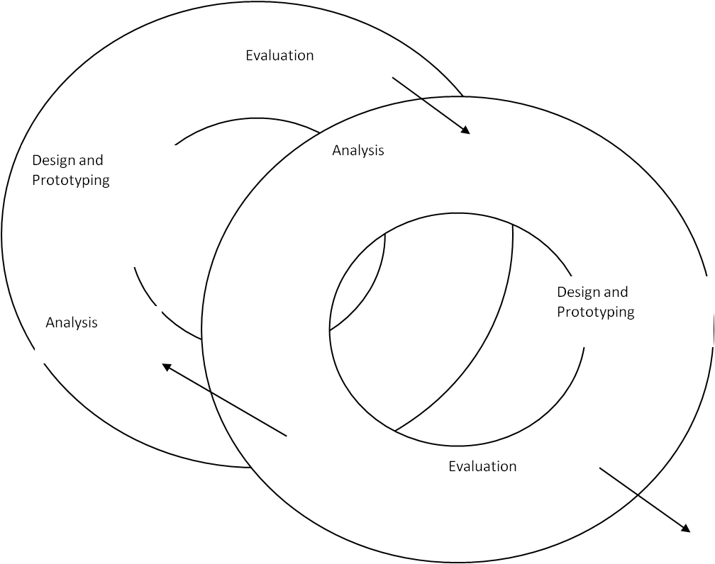
Step 1.9 Review Model with User

Slide 27
Step 2.1 Create Tables
  Move from entities to tables.
  Most entities will have a one-to-one mapping of entity to table.
  Document in a data dictionary

Slide 28
Entities to Tables - 1
  Decompose any ‘many to many’ relationships
An order is for many items and
an item might be on many
orders
Order
Item
Order
OrderItem
Item

Slide 29
Entities to Tables - 2
  Some domains will become separate tables
  If a ‘type’ attributes has many values and these are dynamic then a look-up table to support the domain should be added.
  Product_Type, Student_Type

Slide 30
Step 2.2 Check Table Structure using Normalisation
  Use the normalisation techniques discussed in the previous lecture to check the tables
  Do the tables you have from the top-down method match those from the bottom-up (normalisation) method?

Slide 31
Step 2.3 Check Tables Support user Transactions
  As the CRUD matrix checked that the ER supported the transactions a similar check should now be made for the tables.

Slide 32
Step 2.4 Check Business Rules
  This begins the process of check integrity rules and other constraints.
    Check required data
    Column domain constraints
    Entity integrity
    Multiplicity
    Referential intgrity

Slide 33
Step 2.5 Review Logical Design with Users
This is vital!

Slide 34
Learning Outcomes
By the end of this topic students will be able to:
  List the steps in logical design
  Give an account of the main activities that make up logical design
  Check the integrity constraints on their data model

Slide 35
References
  Connolly, T. and Begg, C. (2004). Database Systems: A Practical Approach to Design, Implementation, and Management, 4th Edition. Addison Wesley – Chapters 9 and 10

Slide 36
Topic 3 – Enhancing Design (2)
Any Questions?
Notes:
NCC Education - End Slide Master

